Slide 1
SDLC & Agile Scrum

Slide 2
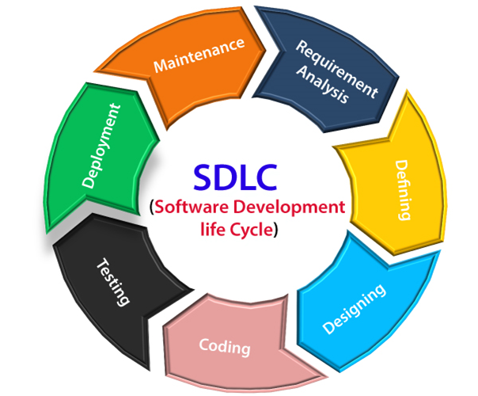
What is SDLC?
SDLC is a process followed for a software project, within a software organization

Slide 3
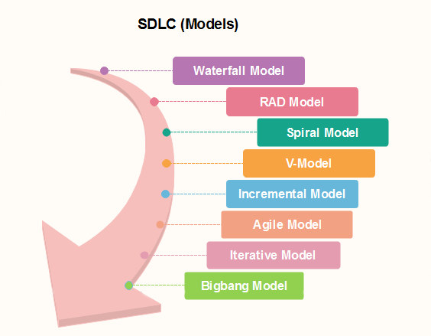
Here, are some important phases of SDLC life cycle:

Slide 4
What Is Agile Scrum Methodology?
Sprint-based project management system.
Combination of the agile philosophy + the scrum framework.
Agile means “incremental, allowing teams to develop projects in small increments.
Scrum is breaking projects down into sizable chunks called “sprints.”

Slide 5
Benefits of agile scrum methodology?
Flexibility and adaptability
Creativity and innovation
Lower costs
Quality improvement
Employee satisfaction
Customer satisfaction

Slide 6
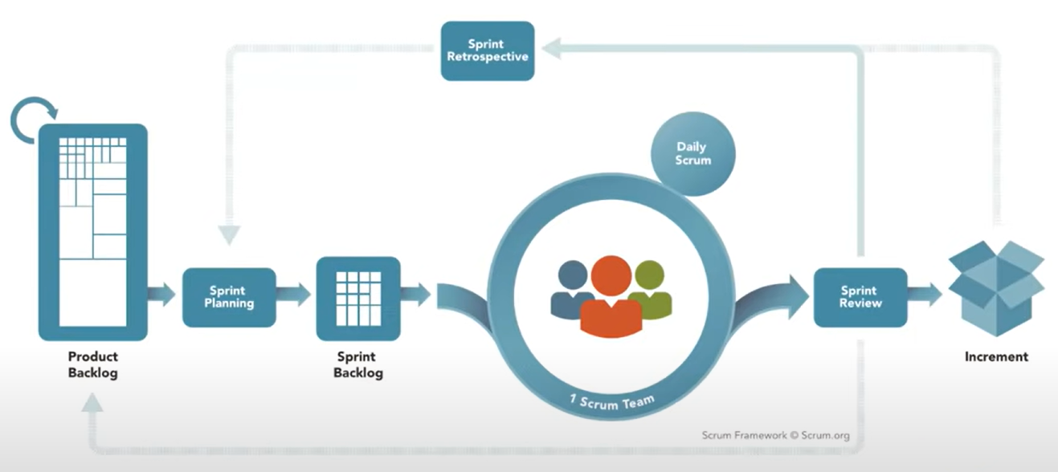
Scrum Framework

Slide 7
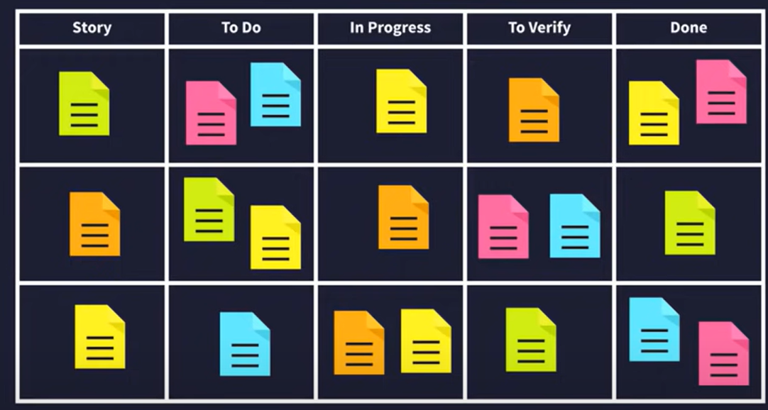
The Scrum Board

Slide 8
Scrum Board
To Do | In Progress | To Verify | Done
What did you do yesterday
Do you have any obstacles |  |  | Done
Home Page with bootstrap components | Completed | Verified | Done
Login And Registration page design | Completed | Verified | Done
Prepaid/Postpaid/Dongle Plan page design | Completed | Verified | Done

Slide 9
To Do | In Progress | To Verify | Done
Generate Invoice | Completed | Verified | Done
Test the Login page with the mock data |  | Success | Done
Test the Crud Operations in admin page with mock data |  | Success | Done
Deployed the Project |  | Success | Done

